Slide 1
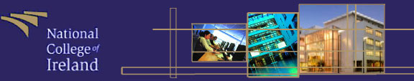
Computer Architecture
Dr Keith Maycock
Mr. Frank Slyne

Slide 2
Computer Architecture
Module Overview:
Teaching method: Lecturing and Labs.
Lecture on Monday 9 am
Labs:

Slide 3
Computer Architecture
Allocation of Marks:
Weekly labs 20% (4 marked labs, week 3, week 5, week 7 & week 12)
Mid Semester exam 30% in week 9
Final exam 50%

Slide 4
Computer Architecture
Recommended Reading and Resources:
Computer Organisation and Architecture: Designing for Performance, William Stallings, 7th edition, 2006
Logic and Computer Design Fundamentals, M. Morris Mano and Charles R. Kime, 4th edition, 2008
Structured Computer Organisation, Andrew S. Tanenbaum, 5th edition, 2006
Online Journal publications

Slide 5
Computer Architecture
Course Content:
Computer Design Basics (how information gets around the computer and the internal structure or make-up of different components on the machine).
Combinational Logic circuits (Boolean algebra and logical design)
Digital Systems and Information (number systems, calculations…etc)

Slide 6
Computer Architecture
Course Content:
Computer Hardware and Maintainence
Cloud Computing and future trends

Slide 7
Computer Architecture
Civilization advances by extending
the number of important operations
which we can perform without
thinking about them.
Alfred North Whitehead 1911

Slide 8
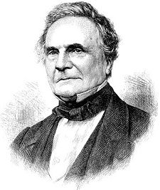
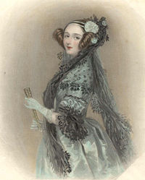
Computer Architecture
Charles Babbage: Analytical Engine (1834)
The design of a mechanical general-purpose computer

Slide 9
Computer Architecture
The Entscheidungsproblem
The Entscheidungsproblem asks for an algorithm that will take as input a description of a formal language and a mathematical statement in the language and produce as output either "True" or "False" according to whether the statement is true or false.

Slide 10
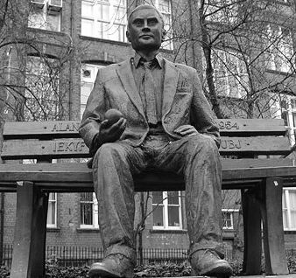
Computer Architecture
Turing Machine:
Turing machines are basic abstract symbol-manipulating devices which, despite their simplicity, can be adapted to simulate the logic of any computer algorithm.
They were described by Alan Turing in 1936.

Slide 11
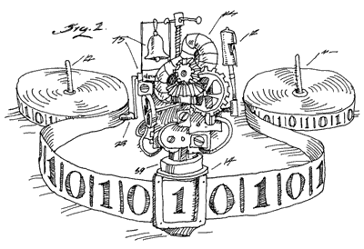
Computer Architecture
Turing machine

Slide 12
Computer Architecture
With Turing machines you have a tape Head to view an input symbol, an input tape, a finite table (instruction set) and a state register.
So if we wanted to use a Turing machine to ensure that the system could recognise all input words for an alphabet L we simply read the input symbols one at a time and follow the instruction set.
Graphically we can use Finite State Machines.

Slide 13
Computer Architecture
Finite State Machines:
All state machines consist of a number of states with input symbols connecting states to represent all the words in a given language.
A language is comprised of letters, letters joined together form words.
Each state is drawn using a circle with a name inside the circle, e.g. s0 (state zero).
s0

Slide 14
Computer Architecture
We move to another state after accepting a letter from a given alphabet (only a single letter can be accepted on a given transition). Example, if we have the alphabet L={a}, then the following would represent a suitable transition.
The above example says that if you are in s0 and you accept an “a” you move to s1.
s0
a
s1

Slide 15
Computer Architecture
Terminating States:
We represent terminating states using an extra inner circle within a state, example,
The above example says that if you are in s0 and you accept an “a” you move to s1, where you can now finish.
s0
a
so
s1

Slide 16
Computer Architecture
Example: Create FSMs for accepting all the words in the following alphabets: L={a, ab} and L={aab, aba}
s0
a
so
b
so
s1
s2
s2
a
b
s0
a
s1
so
s4
b
s3
a

Slide 17
Computer Architecture
Question: Construct a Finite State Machine to recognise all the following words in the following language L = {b, aa, bba, ba, aababaa, aaba, bbaba}.
To Do
Solution:
Firstly, the alphabet only consists of the following letters, “a” and
“b”.
so
a
so
s1
s3
b
s0
a
b
a
s2

Slide 18
Computer Architecture
Around 1944:
John Atanasoff (Iowa State College) and George Stibbitz (Bell labs) produced calculators.
Atanasoffs machine was very advanced, used binary arithmetic and capacitors for memory, which were periodically refreshed to keep the charge from leaking out.

Slide 19
Computer Architecture
The first Generation Vacuum tubes (1945 - 1955):
The stimulus for the electronic computer was World War 2. The English built a machine called COLOSSUS (with Alan Turings help) to decipher messages encrypted using the German ENIGMA machine.
COLOSSUS remained a government secret for 30 years, hence no advancement of the design. It is regarded as the first digital computer.

Slide 20
Computer Architecture
ENIAC (Electronic Numerical Integrator and Computer):
John Mauchley and J. Presper Eckert developed an electronic computer with US military funding (1943 - 1946), called ENIAC.
The computer consisted of 18,000 vacuum tubes and 1500 relays. The ENIAC weighted 30 tons and consumed 140 kilowatts of power. Architecturally the machine had 20 registers, each capable of holding a 10-digit decimal number.
The ENIAC was programmed using 6000 multiposition switches and connecting a multitude of sockets.

Slide 21
Computer Architecture
Since the machine wasn’t ready until the war had ended the ENIAC team held a summer school to show of their computer to fellow researchers. This started widespread development of similar machines.
ENIAC team tried to file for a Patent claiming they invented the digital computer but were turned down and Atanasoff was accredited (even though he didn’t seek a patent).
John von Neumann (also part of the ENIAC team) decided that programming computers with all the switches and cables was too slow and believed that the program could aslo be stored in digital form (IAS machine).

Slide 22
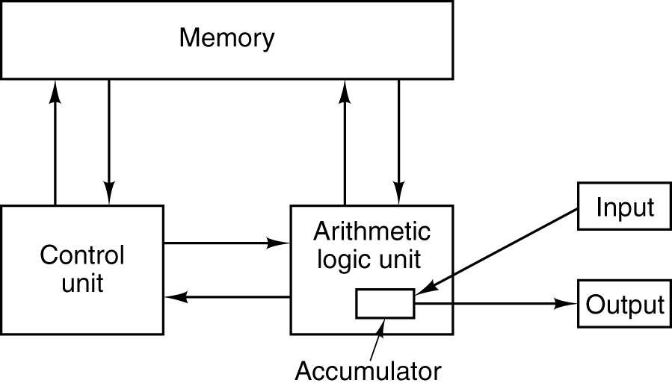
Computer Architecture
Von Neumann machine:

Slide 23
Computer Architecture
Whirlwind 1:
Around the same time as IAS (Von neumann) researchers at M.I.T. were developing Whirlwind 1 had only a 16-bit word and was designed for real-time control.
The project led to the invention of the magnetic core by Jay Forrester, and eventually to the first commercial minicomputer.
IBM was still only involved in generating punch cards and mechanical card sorting machines. IBM produced their first machine in 1953.

Slide 24
Computer Architecture
The Second Generation – Transistors (1955 - 1965):
The transistor was invented at Bell Labs by John Bardeen, Walter Brattain and William Shockley in 1948 which won the Nobel Prize in physics in 1956.
Within 10 years the transistor revolutionised computers and by the late 1950s, vacuum computers were obsolete.

Slide 25
Computer Architecture
The first transistor computer was built at M.I.T.’s Lincoln Lab, a 16-bit machine along the lines of Whirlwind 1 called TX-0.
Kenneth Olsen (one of the engineers who worked on the TX-0 and TX-2) formed a company Digital Equipment Corporation (DEC) in 1957 to manufacture a commercial machine called the PDP-1 (released in 1961).
PDP-1(included a visual screen) was roughly half as powerful as the IBM machine at the time but only cost $120,000 in comparison to the Millions of dollars for the IBM machine.
A PDP-1 was given to M.I.T. where students produced the first computer game called “Spacewar”

Slide 26
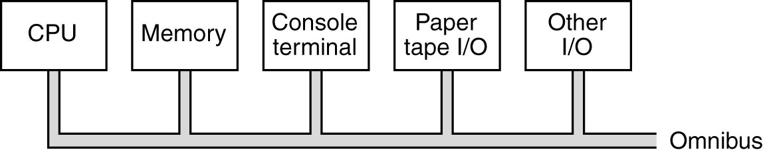
Computer Architecture
PDP-8:
A few years later DEC introduced the PDP-8, which was a twelve bit machine, but much cheaper ($16,000).
The PDP-8 had a major innovation: a single bus, the omnibus. A bus is a collection of parallel wires used to connect the components of a computer (sold around 50,000 PDP-8).

Slide 27
Computer Architecture
IBM and Control Data Corporation (CDC) continued to make faster machines while DEC produced cheap machines.
In 1964 CDC had a major breakthrough with the 6600 model, a highly parallel machine capable of running 10 instructions at the same time. It had additional support for administrative functionality that resembled supercomputers.
The designers of the B5000 machine took a different approach and focused on building a machine that was orientated around software → the idea that software counted was born!

Slide 28
Computer Architecture
The Third Generation – Integrated Circuits (65 - 80):
The invention of the silicon integrated circuit by Robert Noyce in 1958 allowed dozens of transistors to be placed on a single chip. This meant smaller, faster and cheaper computers.
IBM now a major player in the market moved to a single line of production: the System/360. This system included multiprogramming which resulted in higher CPU utilization.
It was also the first system that could emulate earlier systems like the 1401 and the 7094.

Slide 29
Computer Architecture
The fourth Generation:
By the 1980s the Very Large Scale Integration (VLSI) had made it possible to put first 1000s, then 100,000s, and finally 1,000,000s of transistors on a single chip. Prices dropped dramatically → personal computer industry started.
The first operating system became available on the Intel 8080 → file system and shell
Steve jobs and steve Wozniak produced Apple and later Apple II from their garage

Slide 30
Computer Architecture
IBM paid an executive a large amount of money to go of and build IBMs first personal computer.
He picked the Intel 8088 as his CPU and built it from commercial components.
Introduced in 1981 and instantly became the best selling computer of the time.
IBM published the design and the industry exploded.

Slide 31
Computer Architecture
Apple Lisa was the first computer to come with a Graphical User Interface (GUI) but failed to impress as it was too expensive
A year later in 1984 the Macintosh was born.
The first version of the IBM PC came equipped with MS-DOS operating system installed from the then tiny company Microsoft.

Slide 32
Computer Architecture
In 1985 the 386 was released (basically the first Pentium), all modern Pentiums are much faster but have the same kind of architecture.
Until 1992, PCs were either 8-bit, 16-bit or 32-bit however DEC released a 64-bit machine (took about 10 years before they became popular).

Slide 33
Computer Architecture
The fifth Generation:
Quantum computers?
qubits versus bits
http://www.howstuffworks.com/quantum-computer.htm
http://www.qubit.org/
http://www.nytimes.com/2010/11/09/science/09compute.html

Slide 34
Computer Architecture
The fifth Generation:
Integrated devices. The fifth generation is seen more as a paradigm shift as apposed to a specific new architecture.
The concept of pervasive or ubiquitous computing is seen as the fifth generation where everything will and probably should talk to everything else.

Slide 35
Computer Architecture
The Sixth Generation?:
If we can call the ubiquitous computing a generation of computing then we can consider that cloud computing will probably be seen as the sixth generation or perhaps an enhancement of the fifth.
With cloud computing all you need is a dumb machine and a good connection to the internet. Protocols such software as a service and hardware as a service will change the face of computing for many organisations and home users.
Coupled with cloud computing the internet 2 project will give everything an ip address and increased internet speed.

Slide 36

Computer Architecture

Slide 37
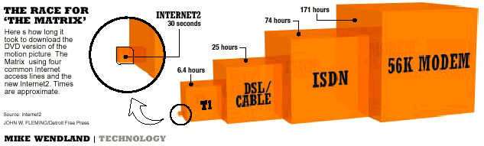
Computer Architecture
Internet 2 project:

Slide 38
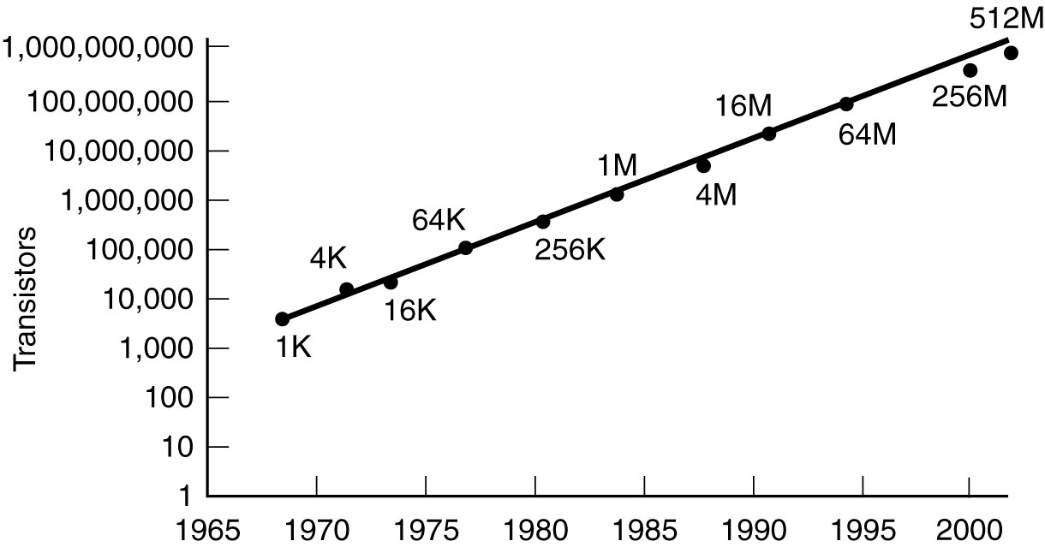
Computer Architecture
Moore’s Law:
Predicts a 60% annual increase in the number of transistors that can be put on a chip.
the year 2020 or 2030 will find the circuits on a microprocessor measured on an atomic scale.

Slide 39
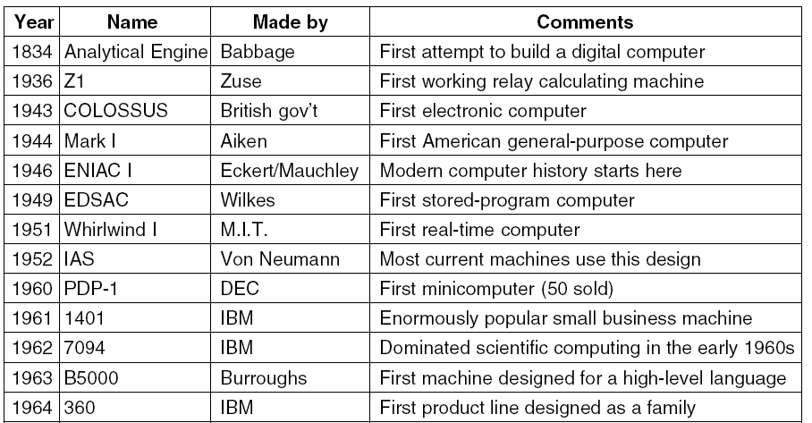
Computer Architecture

Slide 40
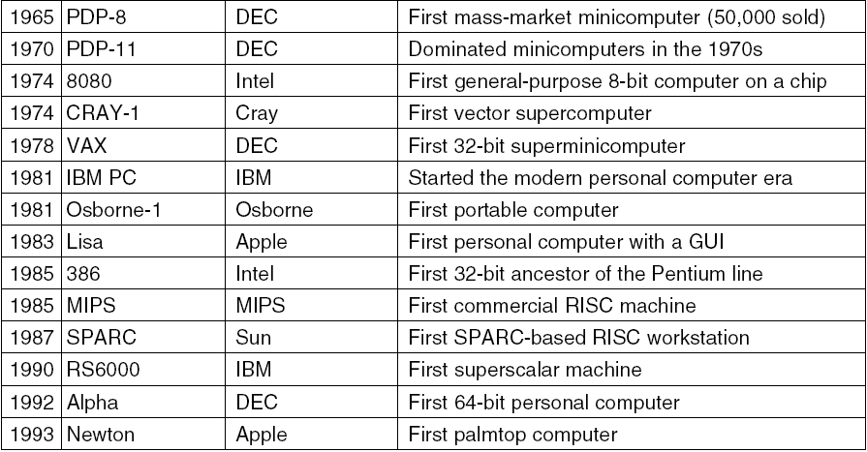
Computer Architecture

Slide 41
Computer Architecture
What was covered?
Both an architectural and mathematical evolution of computers (tubes, transistors, buses, integrated circuits, VLSI).
Finite State Machine, their construction and elements (language, alphabet, words, letters, states and transitions).
Ubiquitous computing, cloud computing and the internet 2 project.

Slide 42
Computer Architecture
Next Week:
Numbers
Modular arithmetic
Number conversions
Binary arithmetic

Slide 43
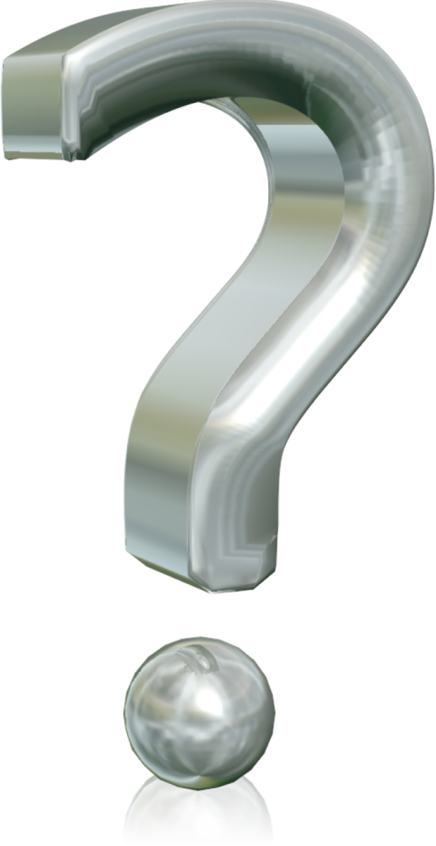
Computer Architecture

